Slide 1
Tech Comm Trends
PROVIDING VALUE AS A GENERALIST IN A SEA OF SPECIALISTS

Slide 2
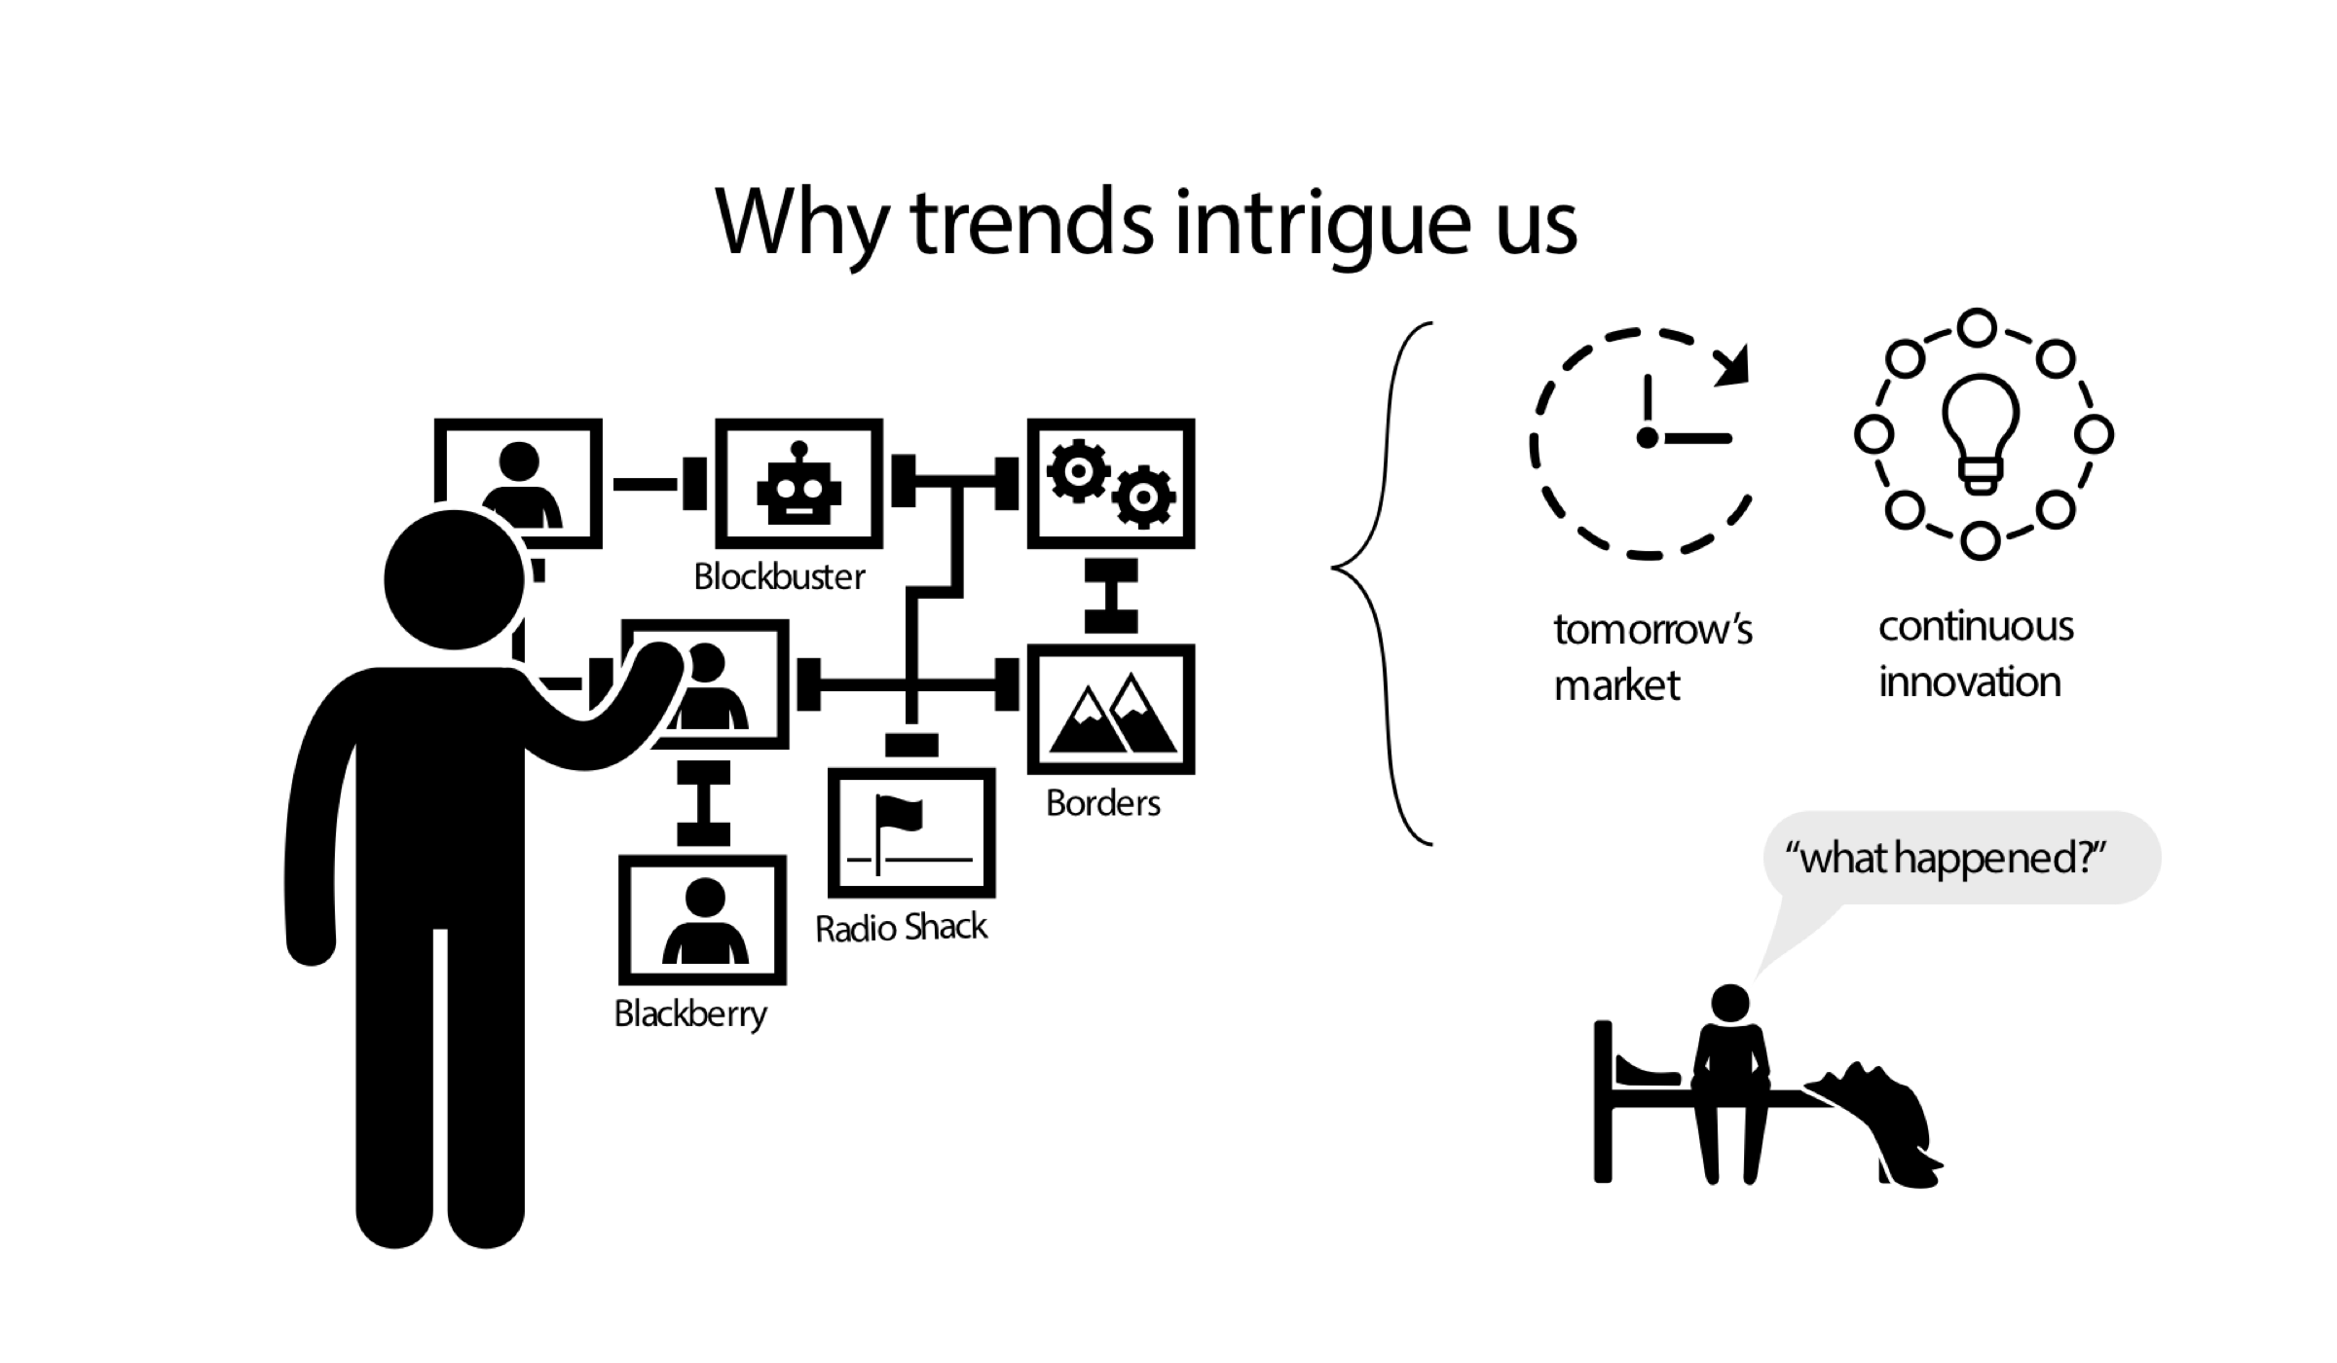
Why trends intrigue
Notes:
companies often vanish
reason: no further innovation; not looking at tomorrow
avoid "what happened?" scenario

Slide 3
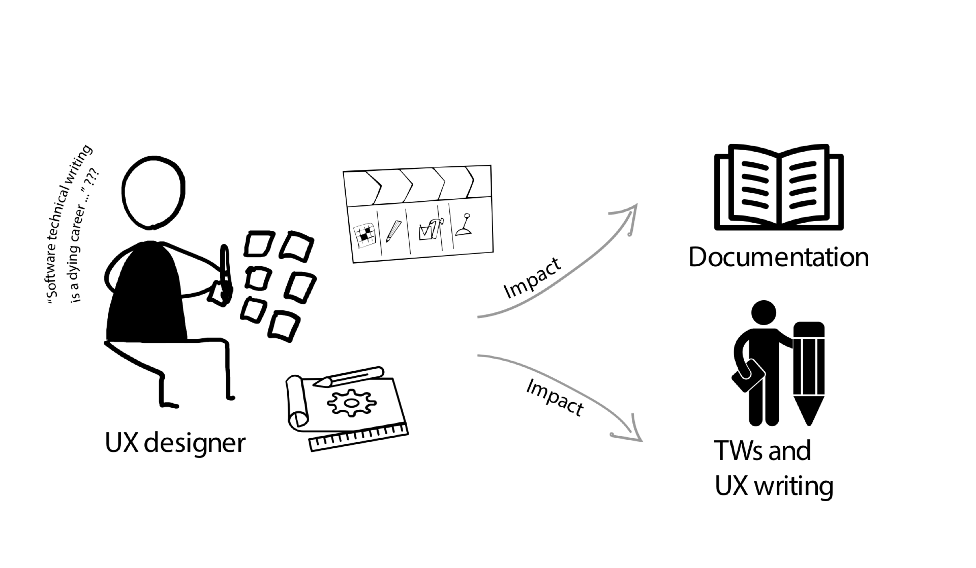
The impact of UX and the need for docs
Notes:
grey's argument: companies hiring UX, not TW
actually, UX can champion TW inclusion
UX might just be one aspect/role among many

Slide 4
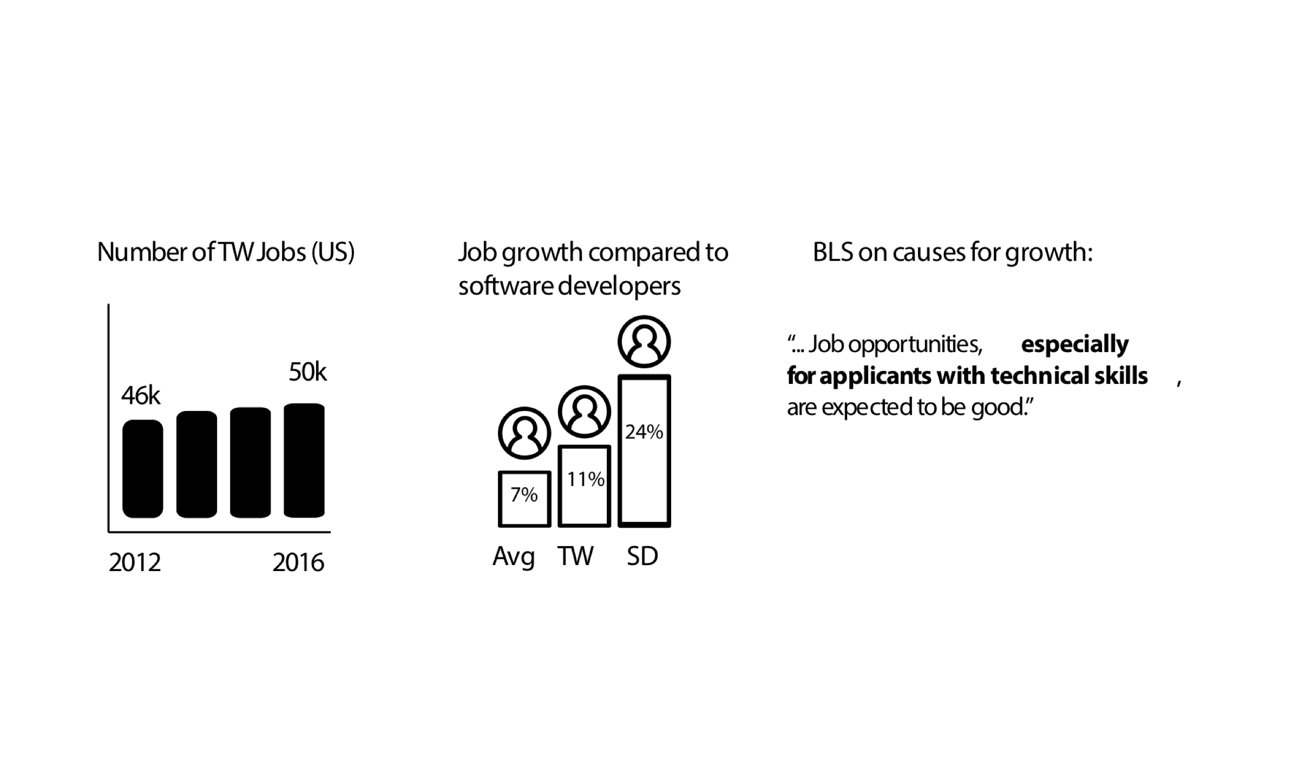
Evaluating trends based on BLS data
Notes:
BLS data shows TW slightly growing
growth rates between engineers & TWs not same (24% versus 11%)
growing number of engineers to support

Slide 5
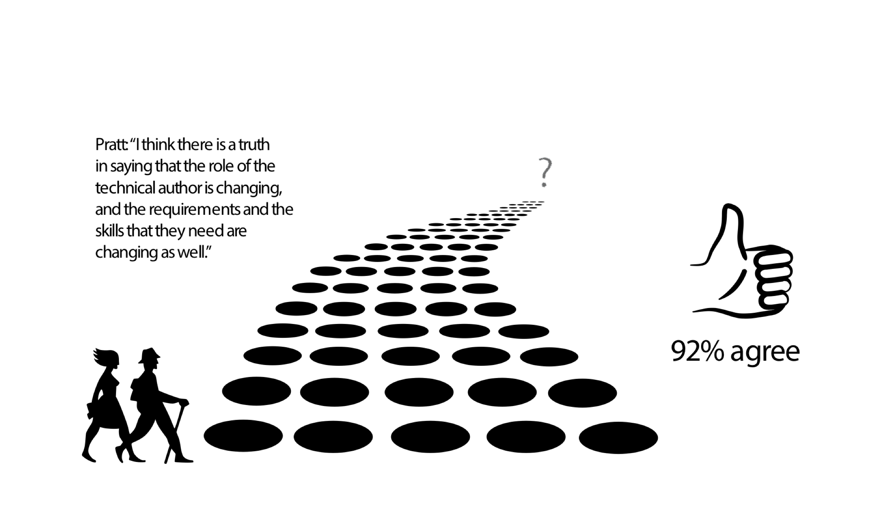
An “evolution” of roles, but towards what?
Notes:
most agree the role is evolving
given tech flux, impossible not to agree
no clear idea of what, though
need data to support assertions about change

Slide 6
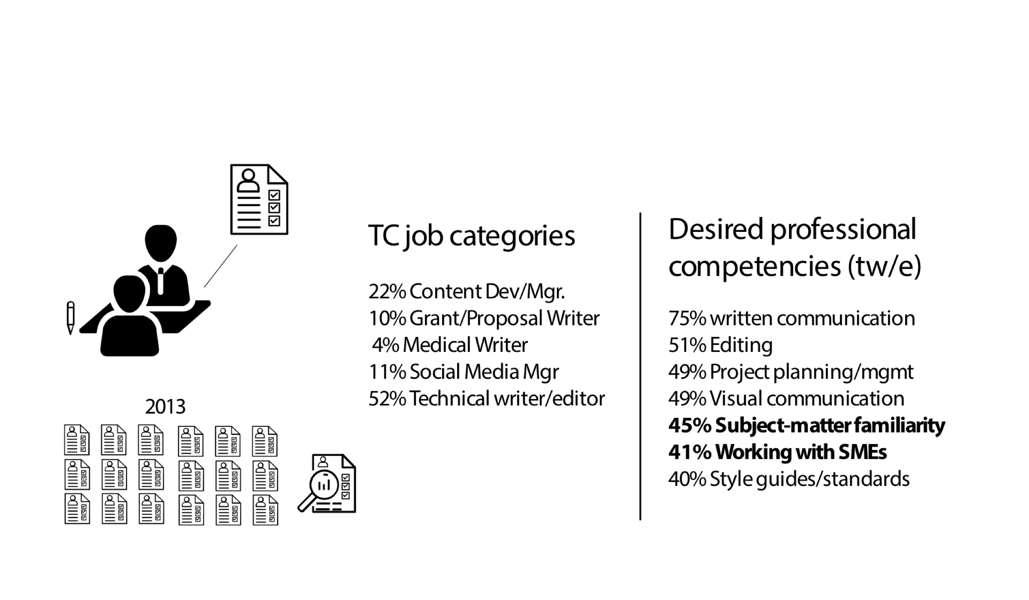
Looking at job ads to extrapolate trends
Notes:
job ads as an ingenious way to infer trends
Brumberger and Lauer study: 1,000 ads, 2013
breadth of TC is much more than TW
social media influence -- multichannel, brand
subject matter familiarity discussion - 45%
mobility of a generalist to pivot careers
multiple specializations, esp. strategic overlap

Slide 7
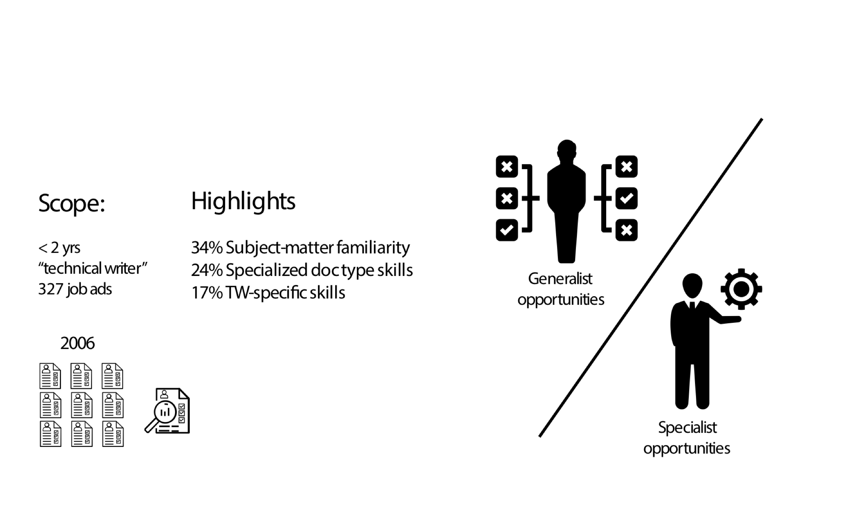
Looking at job ads for trends (cont.)
Notes:
study done in 2003, more on entry level
subject-matter familiarity 34%
not a new trend -- constant criteria
dilemma re generalist vs specialist advantages

Slide 8
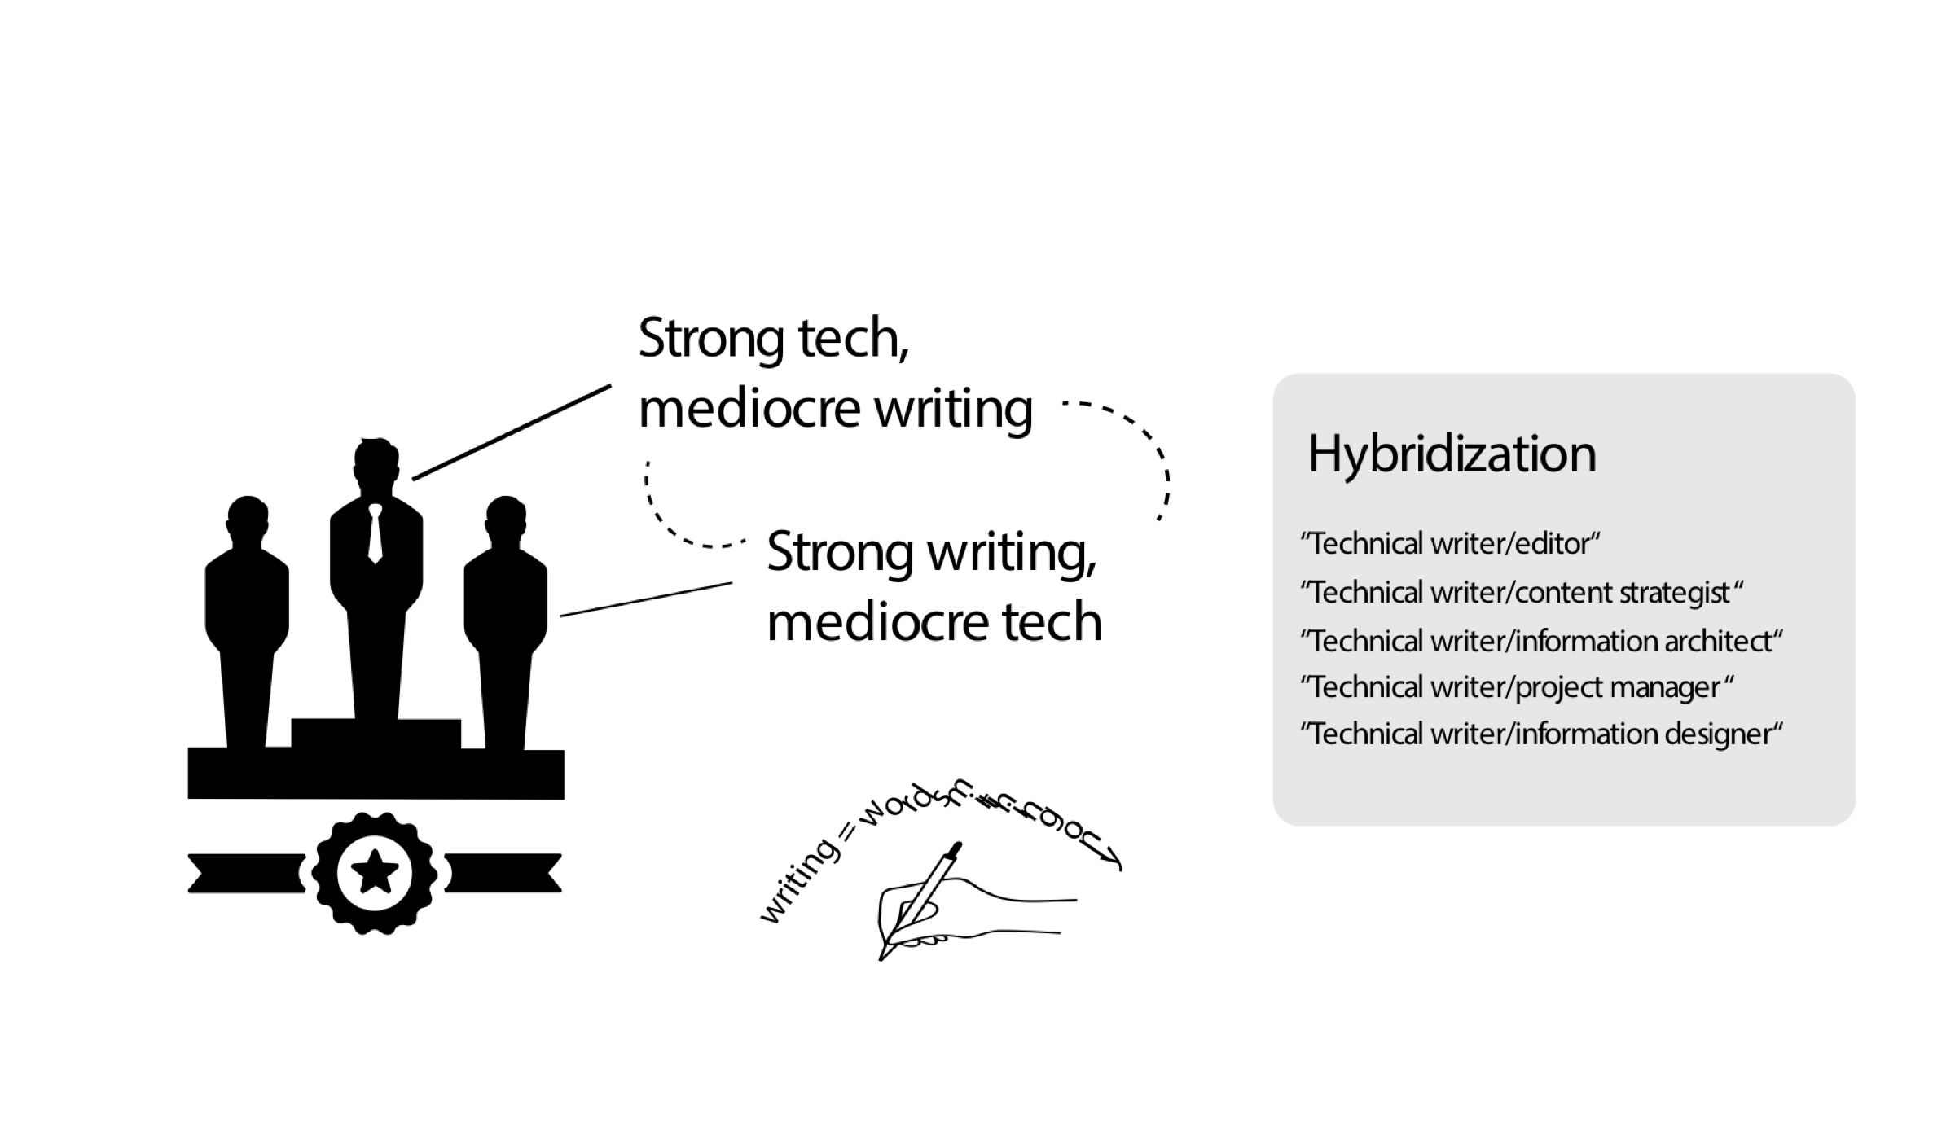
Tech knowledge valued more than writing skills
Notes:
hiring dilemma - which has more value
hybridization used to compensate for low-value of writing
writer is word technician only, not analysis, intellect, strategy
writing is complementary skill only
greek roots of craft

Slide 9
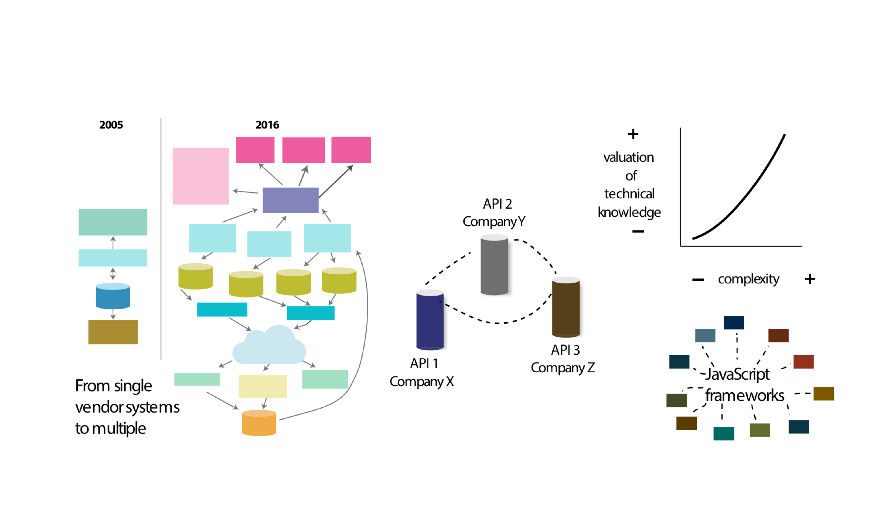
Complexity drives the value of tech knowledge
Notes:
law of supply and demand with knowledge in enterprise
TWs not specialists in valuable area
from single vendor all-in-one systems to multiple systems
proliferation of javascript frameworks
APIs from diff. companies/purposes interacting together in untested ways
hyperspecialization

Slide 10

Simpler on frontend, complex underneath
Notes:
paradox of tech - simpler on frontend, more complex underneath
google home page -- 73 pages of code
natural language processing with alexa interactions
depends which user you're writing for -- if end users, maybe tech is getting simpler

Slide 11
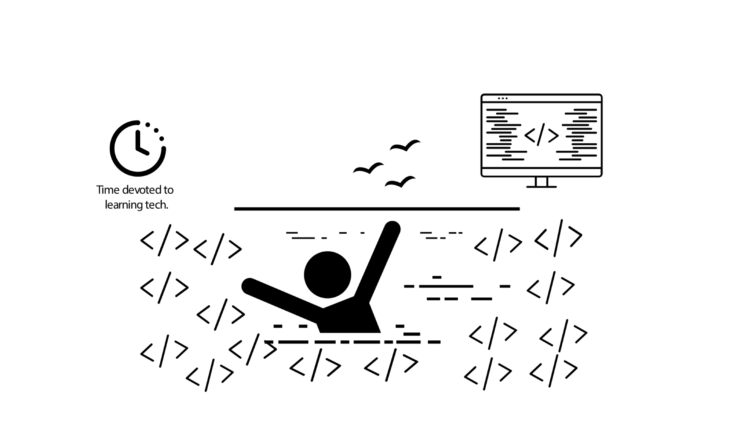
Trying in vain to keep up with the pace of technology
Notes:
virtual chat survey in 2007
time you should devote (30-60+ min.) versus time you actually devote (20 min)
not elbow deep in code like developers all day

Slide 12
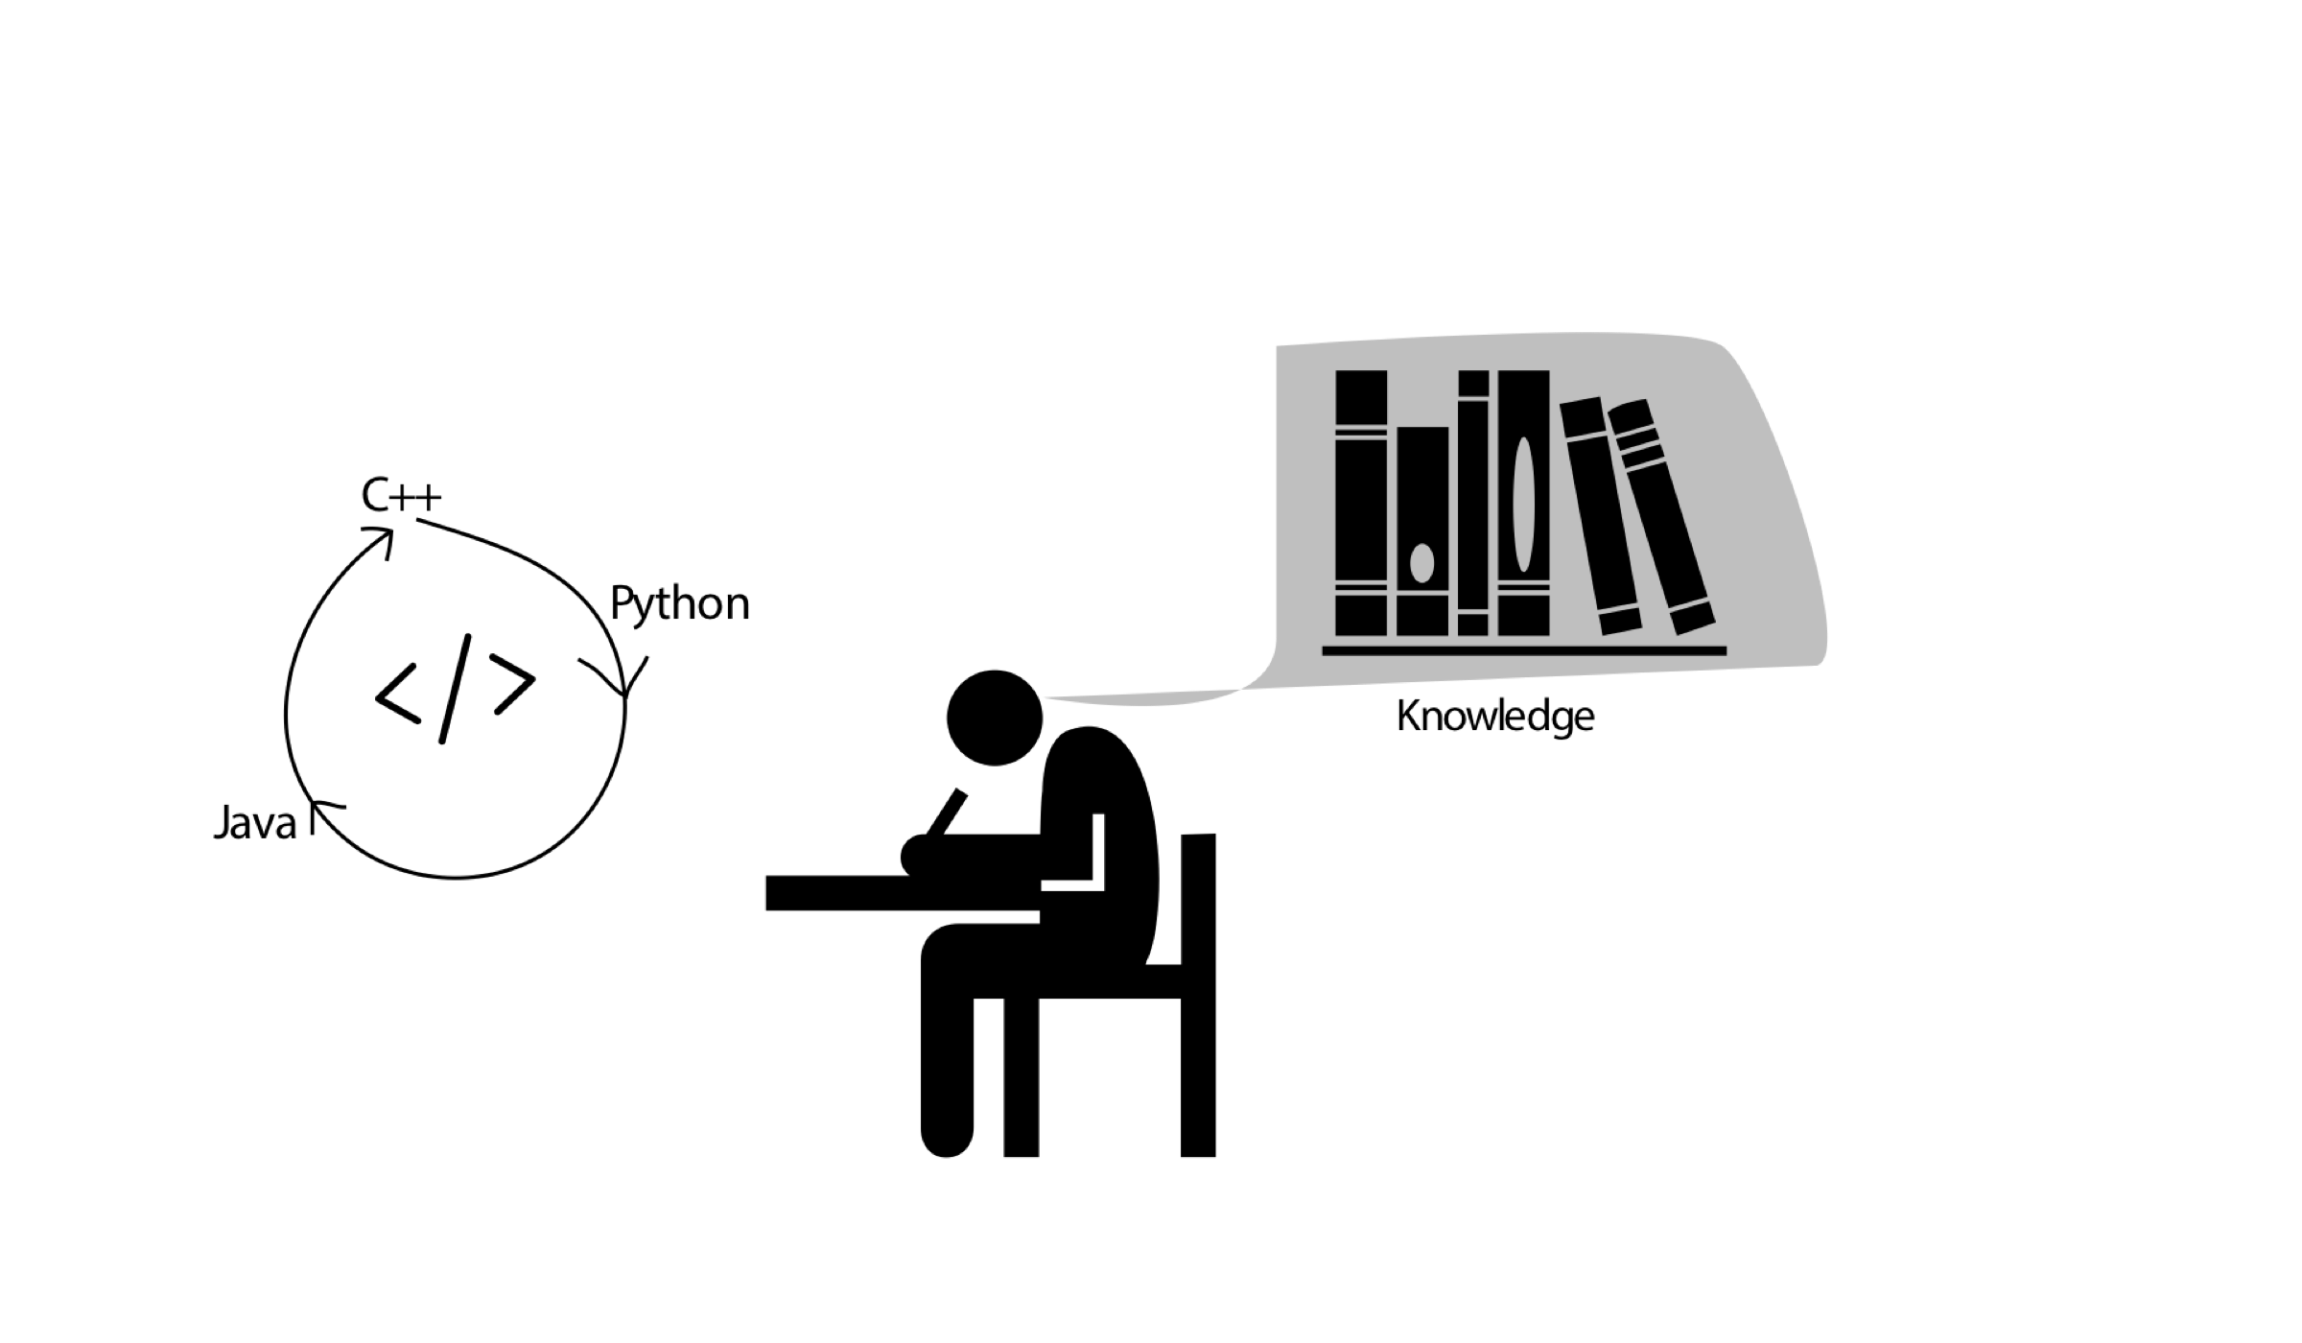
Technical knowledge is essential to writing
Notes:
can't write without knowledge.
your superpower becomes crippled.
neiman: no way to do API doc without strong engineering bg
neiman: convert code samples from 1 lang to another
neiman: 15 min. conversation only, get all details right
rhea: "adequate knowledge only" -- diminishing returns after that

Slide 13
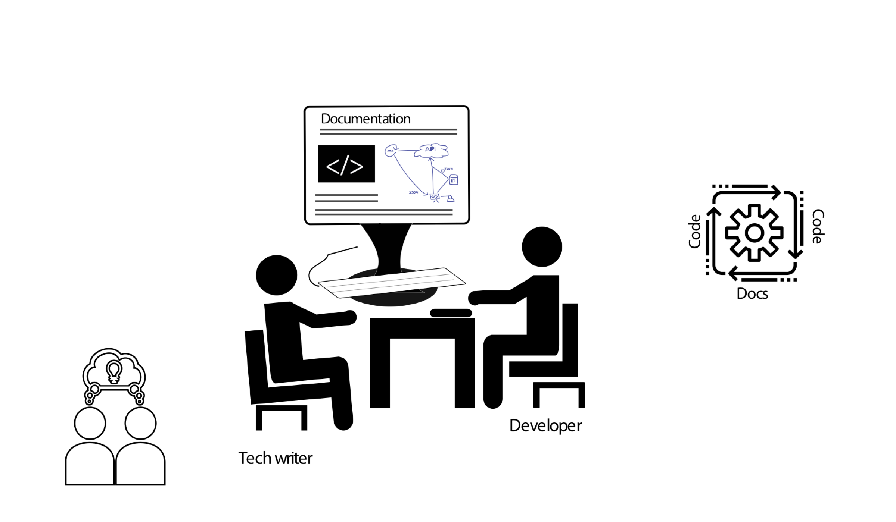
More collaboration in authoring specialized content
Notes:
more resources? here's the Lean-in model
problems with having engineers write: not my job
developer involvement falls on a spectrum
what engineers are good at writing - reference, code
tech writer adds information usability
this is the specialization of the writing process
shift towards docs as code tools

Slide 14

Questions

Slide 15

Where to get more info

Slide 16

Agree/disagree survey

Slide 17

About me
Tom Johnson — idratherbewriting.com — @tomjohnson — tomjoht@gmail.com

